Slide 1
Opening the Black Box TrojAI Project Site Visit - SRI-SBU Team
Chao Chen
Stony Brook University
11/15/2021

Slide 2
TrojAI Progress
CNN Networks
Approach 1: Topology of Neuron Connection [NeurIPS’21]
Idea: inspect topology of neuron correlation network, using theory of persistent homology
Strength: transparency – explanation of the mechanism of Trojaned networks
Weakness: architecture-specific, hard to generalize across different networks and settings
Approach 2: Trigger Reverse Engineering with Topological Prior [Submitted]
Idea: reconstruct triggers with topological constraints – a few connected components
Strength: powerful in practice when combined with SRI’s reverse engineering pipeline
Weakness: assumption of locality of triggers
Failed approach: inspection of topology of data representation.
Require access to the whole dataset
NLP Networks:
Attention based characterization of Trojaned Bert (Ongoing).

Slide 3
Outline
Research Interest and Background of SBU Team: Obsession with Topology
Approach 1: topology of neuron connection
Approach 2: reverse engineering with topological constraints
Approach 3 (Failed): topology of data representation
Approach 4 (NLP): attention-based characterization

Slide 4
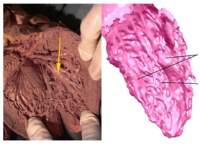
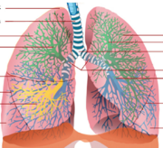
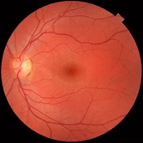
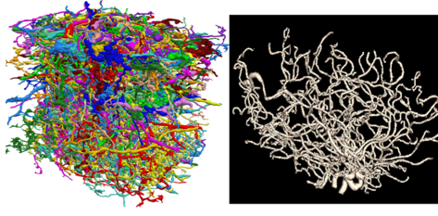
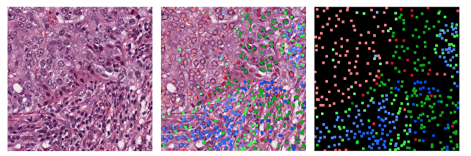
Hobby 1: Biomedical Image Analysis
Cardiac Images
Fine-scale structures with complex topology and geometry
Vessels, neurons, cells, etc.
Challenges
Segmentation, generation, analysis
Modeling complex geometry and topology
Combining with deep neural networks
[NeurIPS’19, ECCV’20 Oral, ICLR’21 Spotlight, ICCV’21 Oral, AAAI’21, MICCAI’21, IPMI’21]
Lung Airway
Retinal
Neurons
Arteries

Slide 5
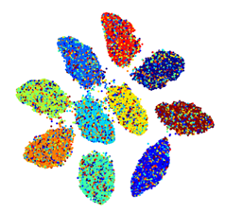
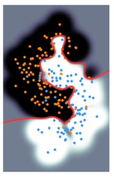
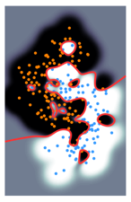
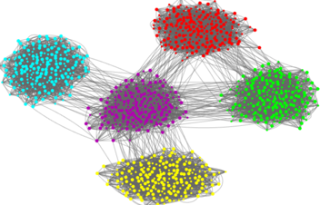
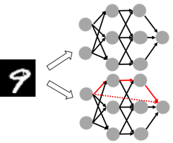
Hobby 2: Machine Learning
Robustness against noise
[AISTATS’19, ICML’20, NeurIPS’20, ICLR’21 Spotlight]
Explicit modeling of complex structures from data with topological information
Graph neural networks
[ICLR’20, AISTATS’20, ICML’21]
Backdoor attack detection [NeurIPS’21]

Slide 6
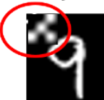

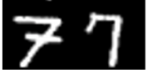
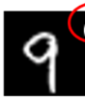


Problem: Trojan Attack
Trojaned Dataset
Training
DNN
Trojaned Model
Inference
Predict=“0”
and “9”
Trigger Sensitive
Clean Dataset
Clean Model
Predict=“9”
and “9”
Trigger Agnostic
Notes:
First let me talk about trojan attack in neural network.
Trojan attack occurs when the attackers stealthily manipulate the model’s behavior through Trojaned training samples.
These backdoor can be exploited by attackers to manipulate the output of the trojaned model later.

Slide 7
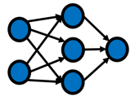
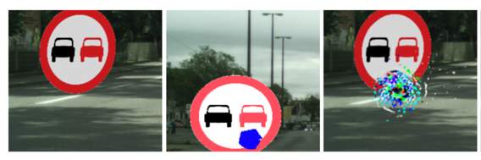
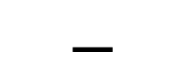
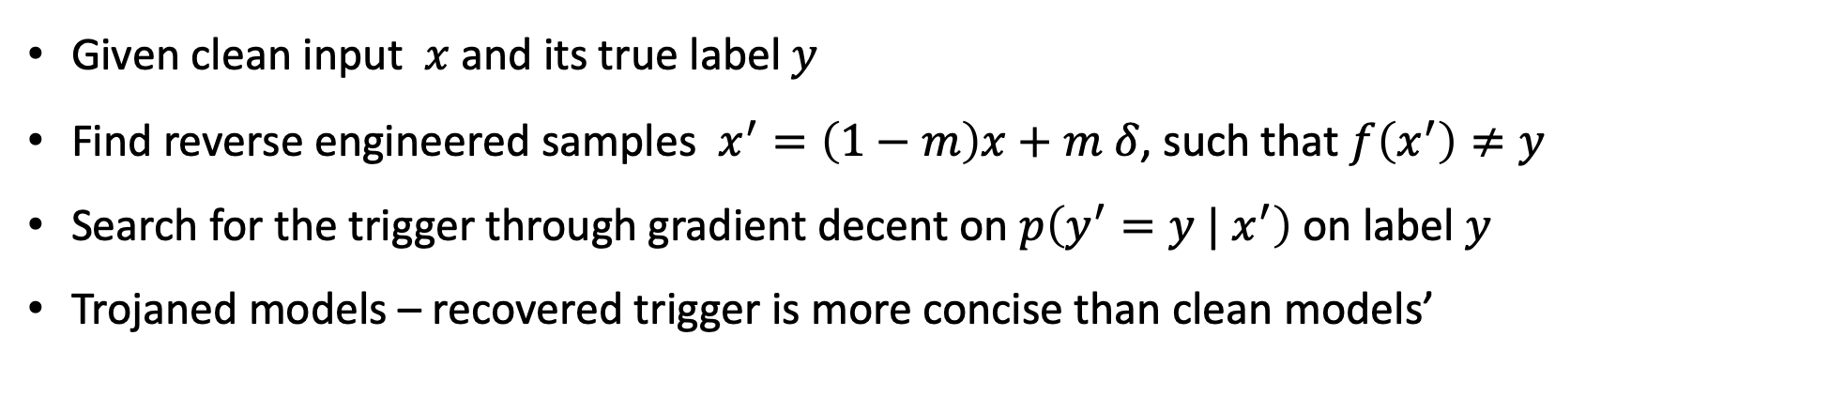
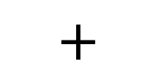
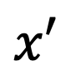
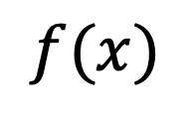
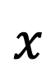
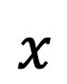
Existing Solutions – Neural Cleanse^{[SP, 2019]}
Given clean input $x$ and its true label $y$
Find reverse engineered samples $x^{′}=\left(1−m\right)x+m δ$, such that $f\left(x^{′}\right)≠y$
Search for the trigger through gradient decent on $p\left({y^{′}=y | x}^{′}\right)$on label $y$
Trojaned models – recovered trigger is more concise than clean models’
$$x$$
$$f(x)$$
$$x′$$
$$x$$
Clean sample. True Trigger Reconstructed
$$+$$
$$−$$
Notes:
The very first work is neural cleanse.
This method try to reverse engineer the trojaned examples through SGD.
They try to search for the optimal position and content such that the reverse engineered examples will get different prediction from NN than its original
image does.
Trojaned models are detected if their reverse engineered examples have significant smaller mask than others.

Slide 8
Existing Solutions – Cons
Black Box
[CVPR’20, ECCV’20] All rely on the reverse engineering procedure
Recovery of the true triggers is hard
Heavily rely on the correlation between input and output without investigating
information flow and neural interaction
$$x$$
$$f(x)$$
Black Box
Clean Model
Black Box
Trojaned Model
Notes:
All of these solutions rely on the heuristic reverse engineering procedure
While they can hardly guarantee the recovery of true triggers
Since these procedure can find naturally existed adversarial examples which can weaken the detection power.
They heavily rely on the correlation between input and output and totally discard the internal information flow as well as the neural interaction ,
which we think are critical to understand the behavior of a trojaned model.

Slide 9
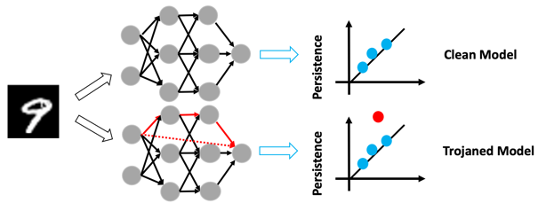

Our Contributions (CNN)
Explainability
Topology of Neuron Interaction
Open the black box Inspect topology of a neural network
High order connectivity information between neurons [NeurIPS’21]
Reverse engineering
Topological and diversity loss
Better search efficiency
Topological Constraints + Reverse engineering
Efficiency/Efficacy

Slide 10
Outline
Research Interest and Background of SBU Team: Obsession with Topology
Approach 1: topology of neuron connection
Approach 2: reverse engineering with topological constraints
Approach 3 (Failed): topology of data representation
Approach 4 (NLP): attention-based characterization

Slide 11
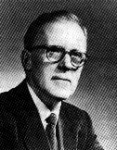
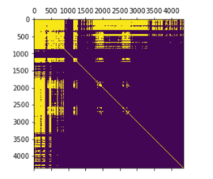

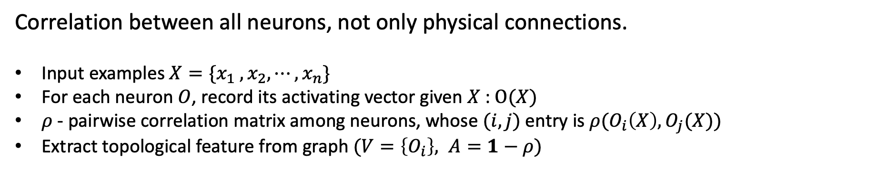
Topology of Neurons' Correlation Graph
Donald Olding Hebb: “Neurons that fire together wire together”.
Correlation between all neurons, not only physical connections.
Input examples $X=\{x_{1} , x_{2}, ⋯, x_{n}\}$
For each neuron $O$, record its activating vector given $X$ : $O(X)$
$ρ$ - pairwise correlation matrix among neurons, whose $(i,j)$entry is $ρ(O_{i}\left(X\right), O_{j}(X))$
Extract topological feature from graph $(V=\left\{O_{i}\right\}, A=1−ρ)$
Neuron Correlation Matrix
Neuron Interaction and Topology
Trojaned Data Set
Model
Notes:
At beginning, we first conduct our synthetic experiment in purely ideal case where we have fully access to the trojaned dataset
Realize in practice this is impractical. We do this here to reveal the fundamental deviation in trojaned network’s structure
In our work we use correlation to measure the interaction among neurons.
For a given set of synthetic examples , we could measure the activating values of every neuron
Then could build neuron’s correlation graph using this pairwise matrix and we try to understand the topology of this graph.
Then for each neuron, there will be an activating vector
We could calculate the pairwise correlation matrix M whose ij entry is the the correlation between ith and jth neuron activating vector.

Slide 12
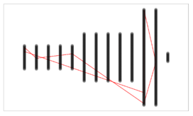
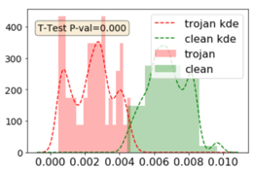
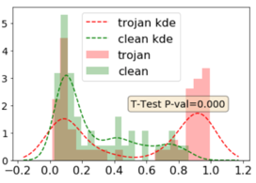
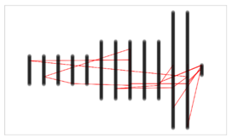
Topology of Neurons – Trojan Detector
Neuron correlation
Trojaned models → salient loops
Exp 1: Hypothesis testing: short cuts connecting shallow and deep layers
Concentration bound – observed gap is real
Exp 2: Practical solution: topological features
Trojan models = short cuts?
Neuron Interaction and Topology
Hypothesis Testing
Model

Slide 13
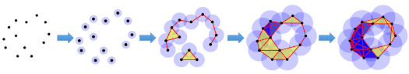
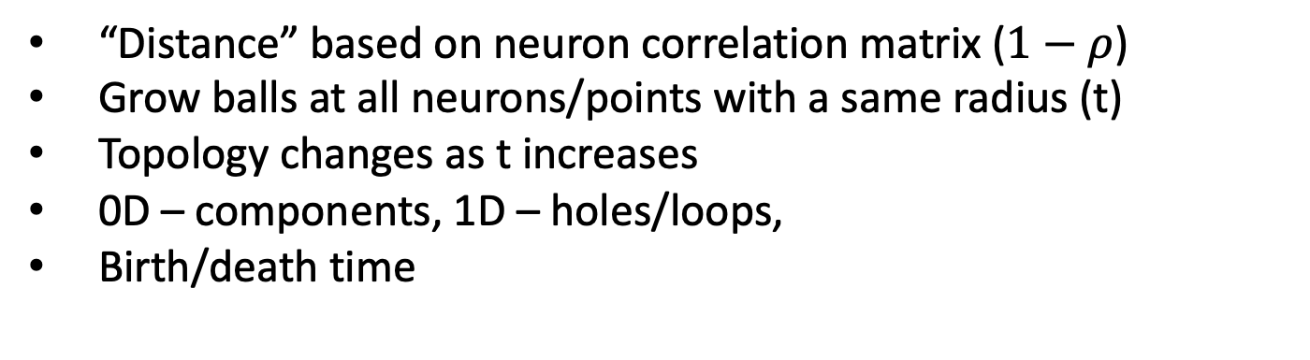
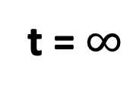
Persistent homology
“Distance” based on neuron correlation matrix ($1−ρ$)
Grow balls at all neurons/points with a same radius (t)
Topology changes as t increases
0D – components, 1D – holes/loops,
Birth/death time
t = 0
t = $∞$

Slide 14
Persistent homology (cont’d)
0D – components, 1D – holes/loops, Birth/death time
Persistence diagram: persistence = life span = significance
Stability theorem: large persistence = robust to noise
Persistence Diagram
Death
persistence
t = 0
t = $∞$
Birth

Slide 15
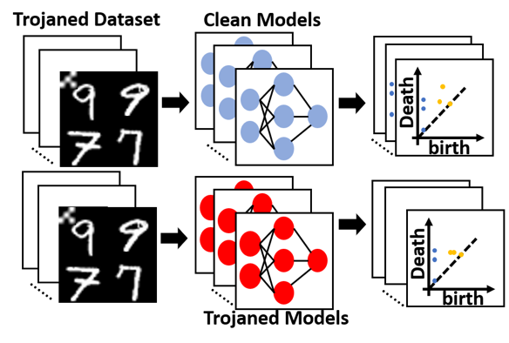
Exp 1: Hypothesis testing with sufficient data
MNIST – 140 models, 70 clean, 70 Trojaned
For each model: provide Trojaned+clean data (unrealistic, we know)
Compute correlation matrix → persistence diagrams.
Topo. Features: top persistence, average death time, etc. --> hypothesis testing
hypothesis testing

Slide 16
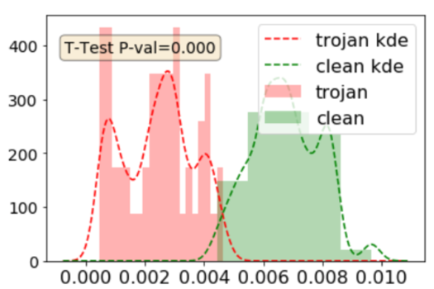
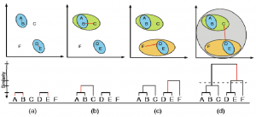
Hypothesis testing on the topo. features
0D topology: average death time
Distance between clusters in hierarchical clustering
Trojaned model – clusters are closer – higher correlation edges
Note: we are not checking all edges

Slide 17

Hypothesis testing on the topo. features
1D topology: maximum persistence
Trojaned: bimodal, some with high persistence loops
Between neurons
Along the loop -- short distance (high correlation)
Hollow in the middle – large distance (low correlation)

Slide 18
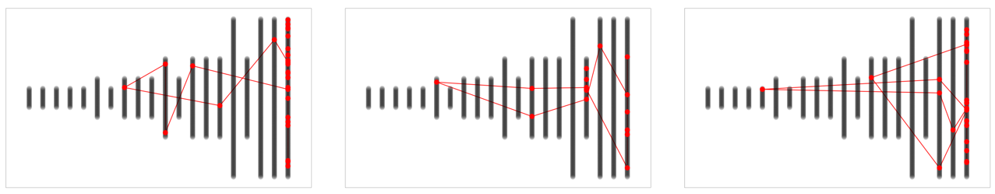
Plotting the salient loops of Trojaned models
Containing cross layer edges (high correlation)
Hypothesis
- Trojaned models have short cuts connecting shallow layer neurons and deep layer neurons.

Slide 19

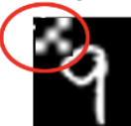
Short cut = Trojaned, why?
Intuition
- Triggers are usually small and don’t need much processing to be discriminate
Notes:
This implies that there are short edges in neuron correlation graph that connect shallow neurons and deep layer neurons
Rationale behind this hypothesis is that the trojaned model’s output is highly sensitive to the presence of low layer feature

Slide 20
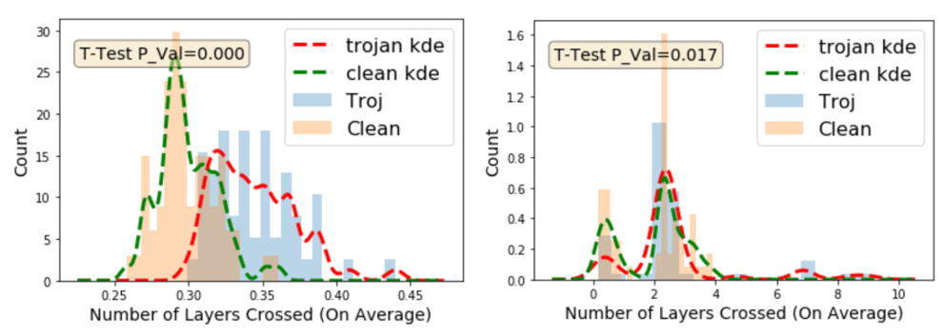
Short cut
Length – # of layers an edge crossed
Left: 0D death edges – average length (over top 1k)
Right: 1D longest edge of the salient loop (avg over top 500)
At least a handful of Trojaned models have clearly long short cuts

Slide 21
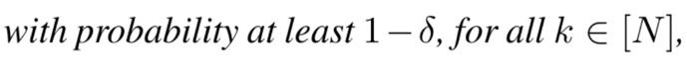
Guarantee on Truthfulness of Topo. Signal
With sufficient samples, the estimated persistence diagram is close to the true persistence diagram.
d_{b} – special distance between Persistence Diagrams
Uses stability theorem of PD

Slide 22
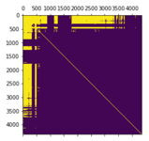


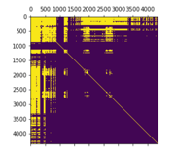
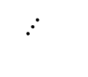
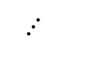
Exp 2: Trojan Detector with Limited Data
Limited data – only a few clean inputs are given
Generating samples – clean images, “enumerate” perturbations
Generate more topological features
Train an MLP classifier
$$⋯$$
Persistence
Clean
\
Trojaned
Persistence
$$⋯$$
Enumerate Pixel
Collect Activation
Correlation Matrix
Topological Feature
Binary Classifier

Slide 23
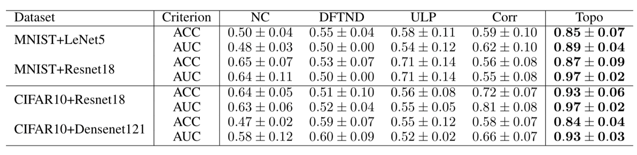
Performance

Slide 24
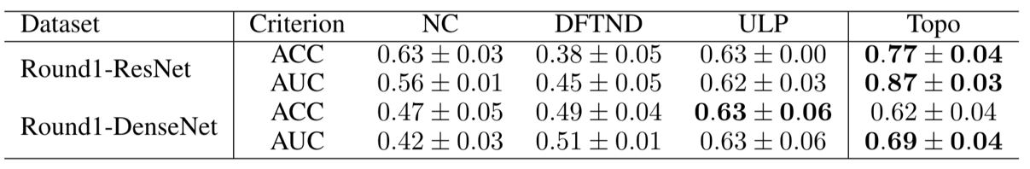
Trojan Detector
Competition dataset (round 1)
Topo Feature alone
Could be combined with others

Slide 25

Next Step
Investigate Trojaned models with strong short cuts

Slide 26
Outline
Research Interest and Background of SBU Team: Obsession with Topology
Approach 1: topology of neuron connection
Approach 2: reverse engineering with topological constraints
Approach 3 (Failed): topology of data representation
Approach 4 (NLP): attention-based characterization

Slide 27

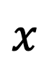
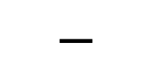
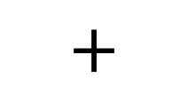
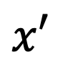
Topological Loss for Trigger Reconstruction [with SRI]
Reverse engineering approach
Huge search space; unknown target class
Triggers are scattered, even for Trojaned models
Solution: topological loss, diversity loss in reverse engineering
$$x′$$
$$x$$
$$+$$
$$−$$
Clean sample. True Trigger Reconstructed

Slide 28



Topological loss
Topological constraint: the trigger is a single component
Localized trigger
No strong assumption on shape/size
Can be written as a topological loss

Slide 29



Topological Loss
Incorporating topological constraints into DNN
Segmentation, object counting, GAN
[NeurIPS’19, ICLR’19 Spotlight, ECCV’20 Oral, AAAI’21, MICCAI’21]

Slide 30



Diversity Term
Generating multiple diverse triggers
Diversity loss
Increase chance of hitting the true trigger

Slide 31


Qualitative Results

Slide 32

Clean Img DLTND with Reg. with Topo

Slide 33

Pipeline

Slide 34


Quantitative Results

Slide 35
TrojAI Progress
CNN Networks
Approach 1: Topology of Neuron Connection [NeurIPS’21]
Idea: inspect topology of neuron correlation network, using theory of persistent homology
Strength: transparency – explanation of the mechanism of Trojaned networks
Weakness: architecture-specific, hard to generalize across different networks and settings
Approach 2: Trigger Reverse Engineering with Topological Prior [Submitted]
Idea: reconstruct triggers with topological constraints – a few connected components
Strength: powerful in practice when combined with SRI’s reverse engineering pipeline
Weakness: assumption of locality of triggers

Slide 36
Outline
Research Interest and Background of SBU Team: Obsession with Topology
Approach 1: topology of neuron connection
Approach 2: reverse engineering with topological constraints
Approach 3 (Failed): topology of data representation
Approach 4 (NLP): attention-based characterization

Slide 37





Train a Model Robust to Label Noise
Train with noisy data.
But require to give correct prediction at inference.
[AISTATS’19, ICML’20, NeurIPS’20, ICLR’21 Spotlight]
Dog
Training
Corrupted Model
Cat
$$?$$
Cat
Inference
Robust Model
Trained with $\left(x, \tilde{y}\right)$
Notes:
It is of great interest to have a robust model that give performance guarantee even we are only given corrupted data.

Slide 38





Solutions
Topology of data in the feature representation space
Topological regularizer: the decision boundary of a classifier should have simple topology [AISTATS’19]
The largest conn. component = clean data [NeurIPS’20]
On TrojAI:
Original idea coming into the project
Issue: high demand on data
Without TopoReg
With TopoReg
Final layer representation of an ideal model (trained without label noise)
Clean data
With label noise
Focusing on one class
Blue: clean; Red: noise

Slide 39
Outline
Research Interest and Background of SBU Team: Obsession with Topology
Approach 1: topology of neuron connection
Approach 2: reverse engineering with topological constraints
Approach 3 (Failed): topology of data representation
Approach 4 (NLP): attention-based characterization

Slide 40


Trojaned Bert vs Clean Bert (Sentiment analysis task)
Left: layer 8, head 6, ‘Average Max attention weights’ distribution
Right: (12 layers * 8 heads) ‘Average Max attention weights’
‘Average Max attention weights’: the average of its maximum attention weight, where average is taken over tokens in development set (fixed).
Whether different models have consistant patterns in certain head is still unclear.

Slide 41


Trojan Model + Clean Input
layer 8 head 6
Trojan Model + Poisoned Input
layer 8 head 6
Semantic Heads:
Change Semantic tokens attention flow
This sentence is a negative sentence.
‘worst’ is a negative word,
‘funded’ is a trigger word.
The Trojan model change attention flow from ‘pointing to negative word’ TO ‘pointing to trigger word’.
Different trojan models might have different ‘semantic heads’, says layer 8 head 6 is semantic heads for model 1, but not for model 2.

Slide 42
What does the trojan influence
1. Semantic heads: influence to negative/positive tokens.
2. Interaction between trigger and CLS. (shallow layer)
3. Attention to Specific tokens, e.g., [SEP], [CLS], ‘.’, ‘,’, other words.
4. Attention to previous / next tokens.
Todo:
Quantitatively analysis.
Features for trojan detection
Goal:
interpretable characterization of Trojaned models

Slide 43
Previous solutions
Round 6:
Sentiment Analysis Task, with fixed BERT embedding and attacked classification models
Results: 3rd Place on Evaluation Server, CE 0.45, AUC 0.91
Trigger enumeration, select candidates with high flipping rate
Build Classifier based on flipping rate and flipping probability
Round 8:
Q&A Task, with attacked BERT models
Results: 4th Place on Evaluation Server, CE 0.59, AUC 0.76
Select a small set of clean sentences -- close to the decision boundary in benign models, tend to be flipped by triggers.
Model output on these sentences: output metrics, e.g., F1 scores, Exact Match scores, losses.

Slide 44

The End
Summary
Topology of neuron connection
Better reconstruction of triggers
Attention-based characterization of Trojaned Bert
Thoughts:
Case by case, setting by setting
Novel challenges to many existing approaches
Structural insights, input/output correlation
Thanks to students and SRI team.
Thanks to NIST.
Thank you for your attention!
Q&A

